Slide 1
Loan Default Prediction
Presented by:
Ravi Kumbar

Slide 2
Our Approach
Understanding Problem Statement
Understanding Dataset
Data Exploration
Feature Engineering
Model Fitting and Prediction
Model Evaluation
Integration with Cloud & Automation
Evaluating New Customer for Loan Approval/Rejection

Slide 3
Business Problem
To Identify loan applicants who are highly likely to default loan repayment based on analysis of historic data using ML tools & techniques

Slide 4
Data Structure
Training Data
19 Features
100k Observations
Test Data
18 Features
10k Observations

Slide 5
Target Variable
“Loan Status” is identified as the target variable.
The distribution of “Fully Paid” vs “Charged off” customers in the train dataset is in the ratio of 77/23
Based on the ratio above we will check if the data is imbalanced based on our model results

Slide 6
Independent Variable
Unique Identifiers
Customer ID
Loan ID
Continuous Variables
Annual Income
Bankruptcies
Credit Score
Current Credit Balance
Current Loan Amount
Maximum Open Credit
Monthly Debt
Months since last delinquent
Number of Credit Problems
Number of Open Accounts
Tax Liens
Years of Credit History
Categorical Variable
Home Ownership
Purpose
Term
Years in current job

Slide 7
Data Dictionary
Variables | Our Understanding
Customer ID | Identify every unique customer with an ID. 81999 unique Customer ID’s are found
Loan ID | Identify every single Loan approved with a Unique ID. 81999 unique Loan ID’s are found
Unique ID’s
Variables | Our Understanding
Purpose | Type of loan – the data provided has 15 unique purpose for availing loan
Years in current job | No. of years in the current job has 11 unique values
Home Ownership | 4 unique Ownership type like Own, Mortgage, etc.
Term | Tenure of Loan. Short term & Long term
Categorical Variable

Slide 8
continued…
Variables | Our Understanding
Annual Income | Annual Income of the Customer
Years of Credit History | Number of years since data for a customer's loan transactions are available
Tax Liens | No. of times the customer did not pay tax
Number of Open Accounts | No. of loan accounts currently open
Number of Credit Problems | No. of times the customer had problem with loan repayment
Months since last delinquent | No. of months since customer’s last missed his loan payments
Monthly Debt | Loan amount per month
Maximum Open Credit | Maximum loan amount that a customer has availed
Current Loan Amount | Loan amount for a customer
Current Credit Balance | Customer’s current loan amount balance that must be repaid
Credit Score | Credit score ranging from (350 to 850)
Bankruptcies | No. of time the customer has filed for Bankruptcies
Continuous Variable

Slide 9
EDA - Exploratory Data Analysis

Slide 10
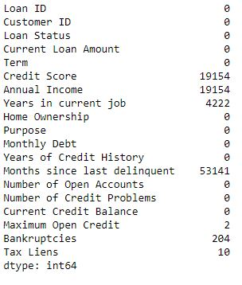
Dropping irrelevant Columns
We found duplicate rows for “Loan_ID” & “Customer_ID” level and hence we kept unique rows at this level
Column’s “Loan ID” and “Customer ID” is dropped as they do not play any role further in prediction
Column “Month since last delinquent” is dropped , as more than 50% of the data is missing in it

Slide 11
“Null/Missing” values Identification & Treatment
Identified 7 columns with missing values
For columns with least missing values we imputed null’s with (Mode)
Maximum Open Credit
Bankruptcies
Tax Liens

Slide 12
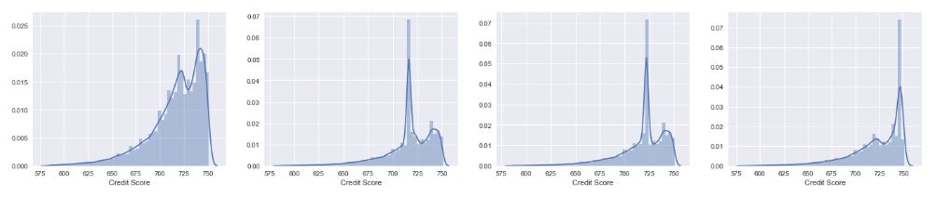
Missing value treatment Continued….
For columns with more missing values we plotted histograms and then treated missing values with (Mean/Median/Mode)
Variable | Imputation Method
Credit Score | Median
Annual Income | Mean
Years in current Job | Mode

Slide 13
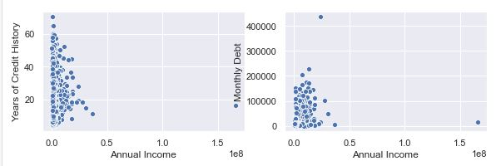
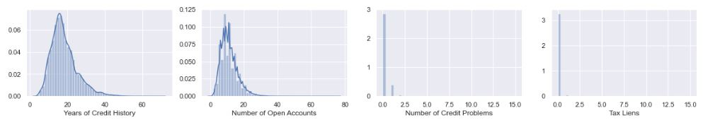
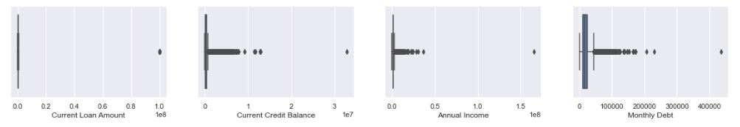
Outlier Detection & Treatment
Univariate & Bivariate analysis using Histograms, Boxplots and Scatter plots were used to detect outliers
Variables with outliers were treated using IQR/Percentile/KNN
Bi-variate Analysis
Uni-variate Analysis

Slide 14
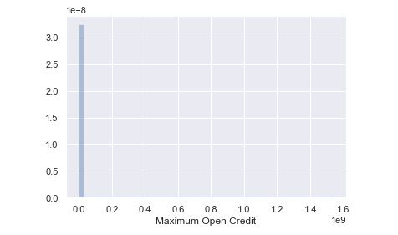
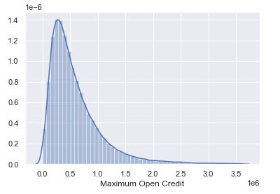
Distribution of variables before & After Outlier treatment
Univariate & Bivariate analysis using Histograms, Boxplots and Scatter plots were used to detect outliers
Variables with outliers were treated using IQR/Percentile/KNN
Shown below is an example of outlier treatment for variable “Maximum Open Credit” before and after (graph in the left & right respectively)
Before
After

Slide 15
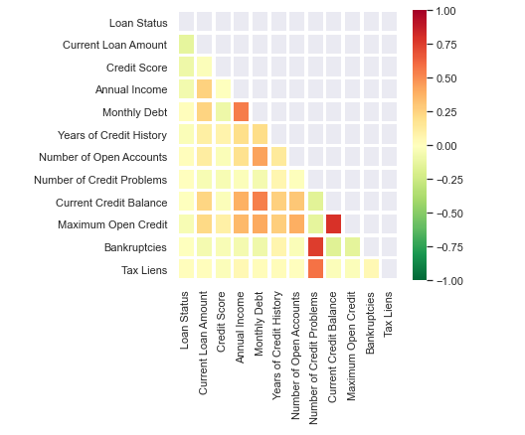
Feature Reduction
Tested or Correlation between independent variables
Used Pearson Correlation to get Corr-Plot
Eliminated Variables that are highly Correlated(0.75 and above)
Also Eliminated variables with where more than 80% of the data are “0”

Slide 16
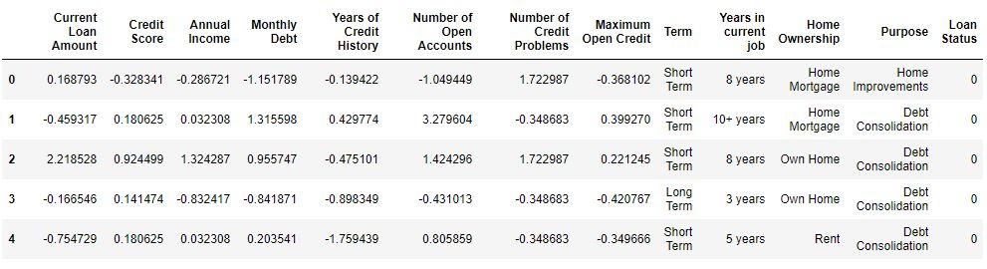
Feature Scaling
As some of the Classification algorithms (like Logistic Regression/KNN, etc.)uses distance between 2 points to arrive at the predictions.
The high difference in values will impact the final output (predictions)
We used Standard Scaler to avoid the above issue in the data set before fitting the model

Slide 17
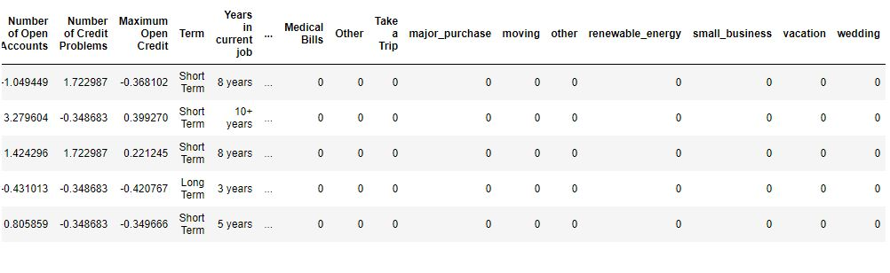
Creating Dummy Variables
For Categorical variables , we did One-hot encoding to create additional columns for each unique observation in each categorical variables.

Slide 18
Sampling Techniques to Balance Dataset
Since the no. of “Defaulters” are only 22% of the entire training dataset, we performed sampling techniques as mentioned below to balance the dataset before modeling
Under sampling
Over sampling
SMOTE

Slide 19
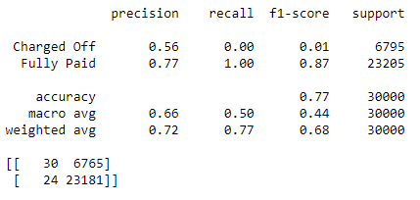
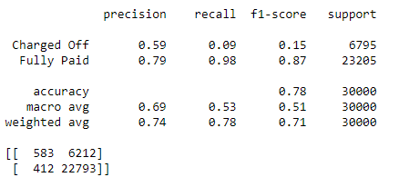
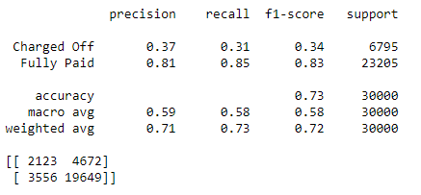
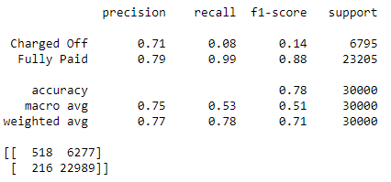
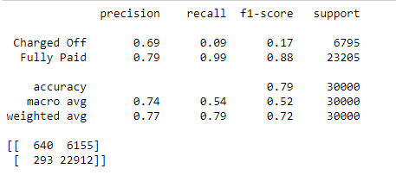
Model Output without Sampling
Logistic Regression
Decision Tree
KNN
XGBoost
Random Forest

Slide 20
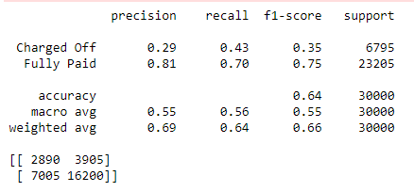
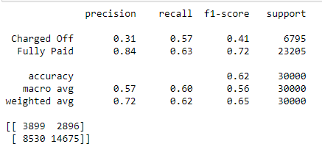
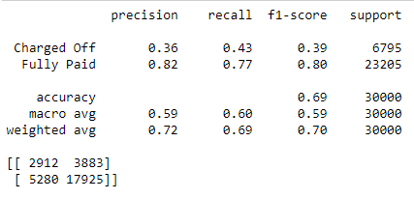
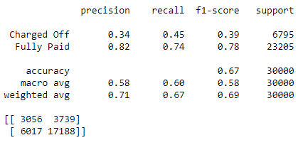
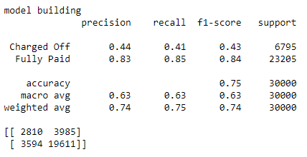
Model Output after Sampling
Logistic Regression
Decision Tree
KNN
XGBoost
Random Forest

Slide 21
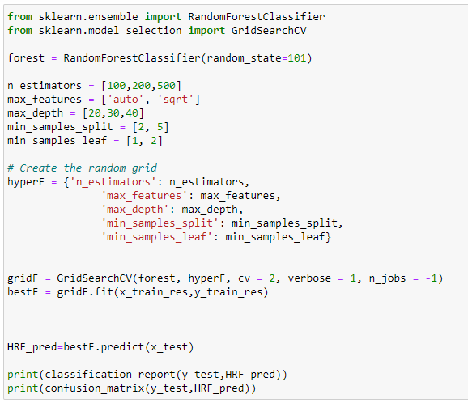
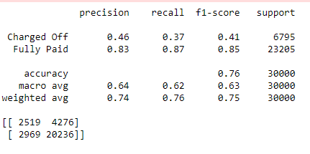
Random Forest with GridSearchCV

Slide 22
Azure – ML Automation & Loan Default Prediction at Scale

Slide 23
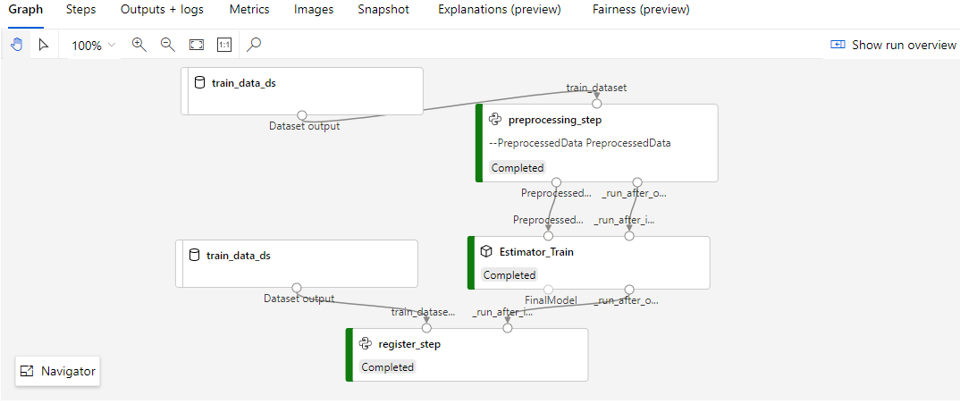
Azure ML - Pipeline
* Data Pre-processing * Model Training * Model Registration

Slide 24
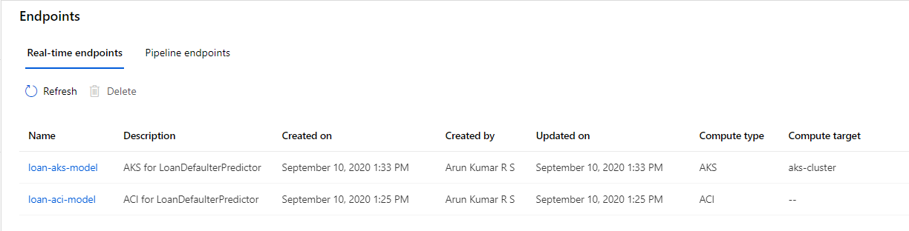
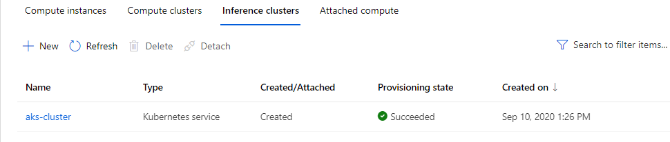
Azure ML - Deployment
* ACI * AKS

Slide 25
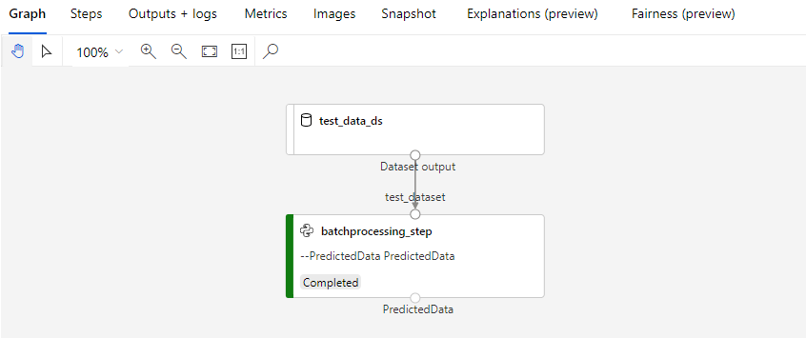
Azure ML – Batch Processing

Slide 26
Mobile/Web Interface for Customers to check Loan Approval

Slide 27

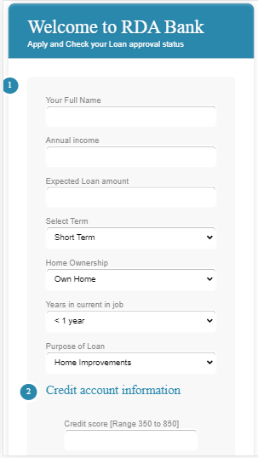
Mobile - User Interface
Built a simple web/mobile user interface for Individual customers to check their loan approval status.
Charged Off – can not be approved
Fully Paid – can be approved
Tech stack used :
Flask(Python) - Back End
HTML and CSS - Front End
Github - Version Management
Heroku - PAAS on AWS

Slide 28
File Structure
File structure that must be followed in case of creating website or app using flask and heroku
.git
static
logo.png
style.css
templates
index.html
app.py
Procfile
requirements.txt
model.pickle /model.joblib

Slide 29
Integrating Front End with BackEnd
Front end : index.html
Once customer hits the link html form will open.
Customer provides input to form and click on check my application status button.
Back end - app.py
Inputs are fed in sequential manner that can be understand by the model.
Already trained Model will predict the output.
Output will be rendered in html table.

Slide 30
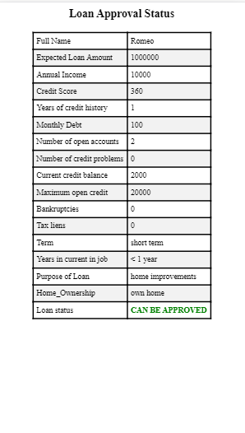
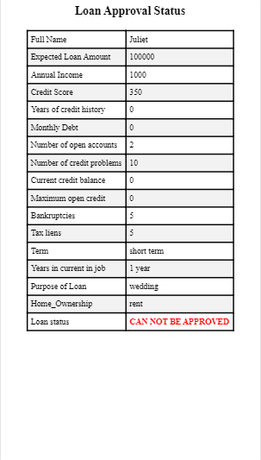
Loan Approval/Rejection status displayed

Slide 31
Deploying on Heroku
Procfile
This will tell heroku to start web process with specified file name.
Requirements.txt
python packages that are required for model to predict.
Version management:
$ git add .
$ git commit -am "make it better"
$ git push heroku master

Slide 32
THANK YOU
LET’S BUILD SOMETHING
AMAZING TOGETHER…

